Slide 1
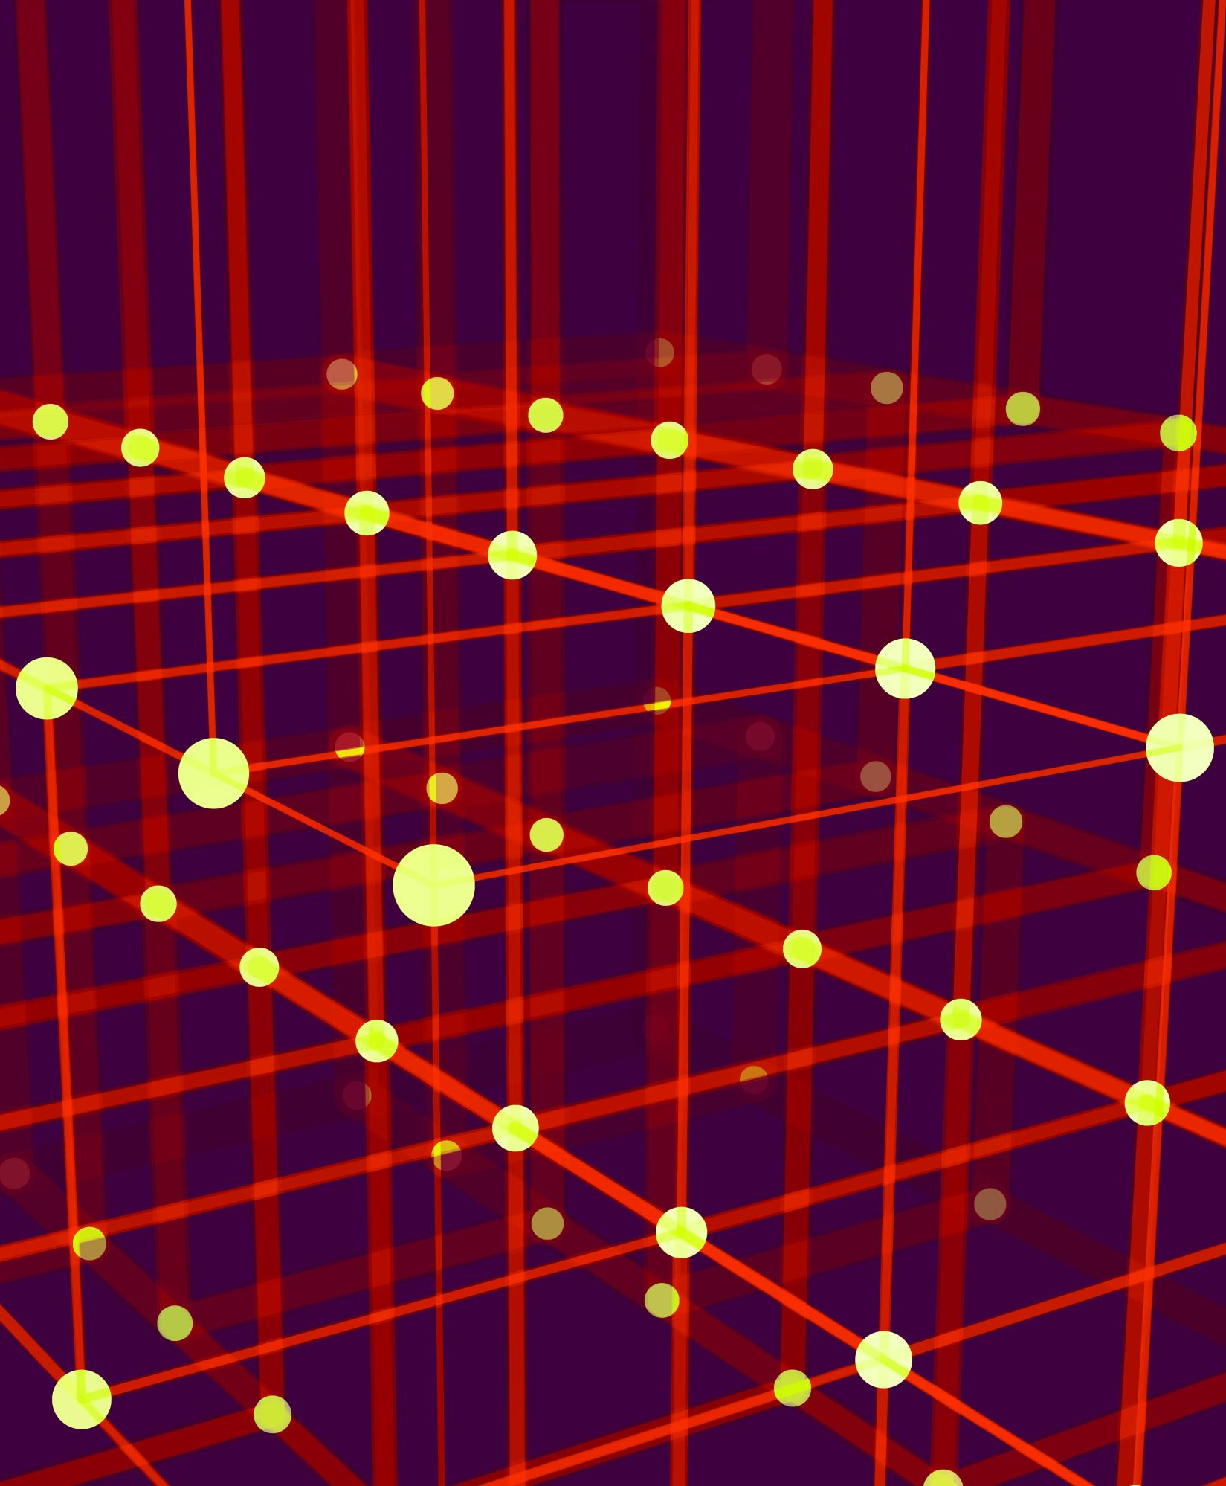
Week 12
Espruino Tools

Slide 2
Progress
Demo Site
Demo site design has been implemented.
Improved the way the demo site gathers new demos. This is done by utilizing the GitHub api to get a tree object of the files in the directory, by filtering this to the specific project we can grab the files. On top of this now the project will just automatically gather each project in the ‘demos’ folder creating a new route and page for them.

Slide 3
Progress (cont.)
Testing
Investigated using JEST for writing unit tests on packages.
Explored the idea of mocking through JEST, this in theory should allow us to mock a web Bluetooth connection to run the code, this will at first be used to ensure the correct code is being written with our methods. This could potentially be used for the peer package as well,
For the NPX tool I plan on writing a simple script to
Check the directory is correct, this will essentially run the npx tool then use a recursive ‘ls’ command and will convert the file structure into a tree and compare with a predefined object.
This will need to check each tag; each branch so may end up with 16+ tests and may cause problems with storage on the AWS server so will need to remove the created directory after each test is done.
Check package.json to ensure packages have been installed properly.
Checking file content may be a route to go down but it seems like a waste of time to me as this would be a problem with the git clone package and not my own.

Slide 4
Extras.
Found an example of a JavaScript transpiler used for the svelte framework, ive noted this down for future reference.
I plan on utilizing something like svelte or any other js framework to build one of the demos just to show that this package works regardless of the framework behind it.

Slide 5
Decisions Made
Using ‘Prism’ on the demo site for showing the code.
Using Github’s API to gather repo data.
Using JEST for testing the NPM packages.

Slide 6
Questions
What level of testing is required for my project; do I need to test the demo site? The documentation?
Documentation seems like a bit of a waste of time to me as I’m using a very basic implementation of docusarus which wont even run if there is any errors.

Slide 7
What’s Next? (This Semester)
Add package testing discussed previously.
Create Puck Light Demo, and any other I have time for.
Continue with dissertation.

Slide 8
What’s Next? (Next Semester)
Create Transpiler
Create Online IDE
Populate Dissertation
Produce remaining demos and as many more as possible

